Slide 1

CS 1674: Intro to Computer Vision Convolutional Neural Networks
李翔
2021/09/13

Slide 2
Plan for the next few lectures
Why (convolutional) neural networks?
Neural network basics
Architecture
Biological inspiration
Loss functions
Optimization / gradient descent
Training with backpropagation
Convolutional neural networks (CNNs)
Special operations
Common architectures
Practical matters
Tips and tricks for training
Transfer learning
Software packages
Understanding CNNs
Visualization
Synthesis / style transfer
Breaking CNNs

Slide 3
Neural network basics

Slide 4
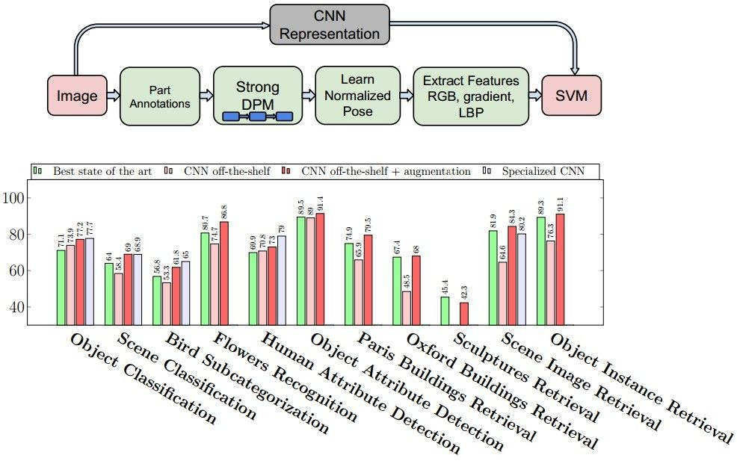
Why (convolutional) neural networks?
State of the art performance on many problems
Most papers in recent vision conferences use deep neural networks
Razavian et al., CVPR 2014 Workshops

Slide 5
ImageNet Challenge 2012
~14 million labeled images, 20k classes
Images gathered from Internet
Human labels via Amazon Turk
Challenge: 1.2 million training images, 1000 classes
[Deng et al. CVPR 2009]
A. Krizhevsky, I. Sutskever, and G. Hinton, ImageNet Classification with Deep Convolutional Neural Networks, NIPS 2012
Lana Lazebnik

Slide 6

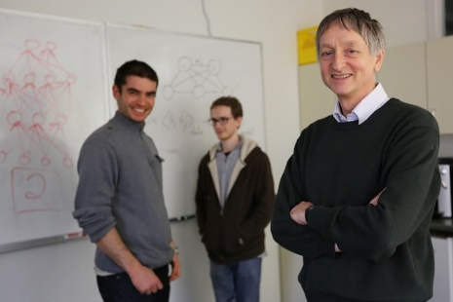
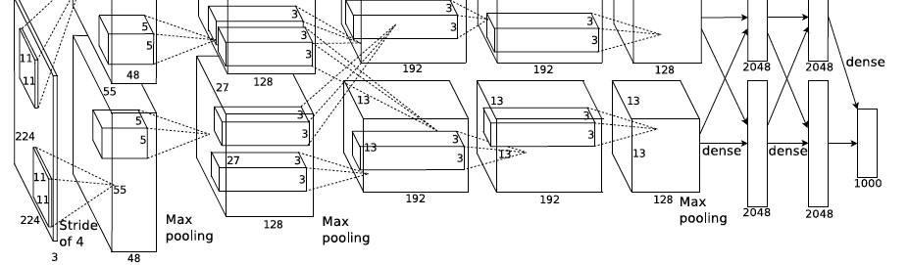
ImageNet Challenge 2012
AlexNet: Similar framework to LeCun’98 but:
Bigger model (7 hidden layers, 650,000 units, 60,000,000 params)
More data (10⁶ vs. 10³ images)
GPU implementation (50x speedup over CPU)
Trained on two GPUs for a week
Better regularization for training (DropOut)
A. Krizhevsky, I. Sutskever, and G. Hinton, ImageNet Classification with Deep Convolutional Neural Networks, NIPS 2012
Adapted from Lana Lazebnik
Notes:
Two-GPU architecture

Slide 7
ImageNet Challenge 2012
Krizhevsky et al. -- 16.4% error (top-5)
Next best (non-convnet) – 26.2% error
Lana Lazebnik

Slide 8
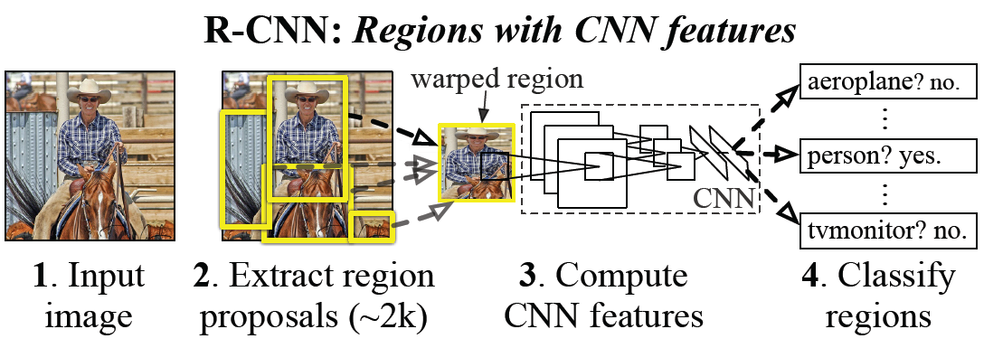
Example: CNN features for detection
Object detection system overview. Our system (1) takes an input image, (2) extracts around 2000 bottom-up region proposals, (3) computes features for each proposal using a large convolutional neural network (CNN), and then (4) classifies each region using class-specific linear SVMs. R-CNN achieves a mean average precision (mAP) of 53.7% on PASCAL VOC 2010. For comparison, Uijlings et al. (2013) report 35.1% mAP using the same region proposals, but with a spatial pyramid and bag-of-visual-words approach. The popular deformable part models perform at 33.4%.
R. Girshick, J. Donahue, T. Darrell, and J. Malik, Rich Feature Hierarchies for Accurate Object Detection and Semantic Segmentation, CVPR 2014.
Lana Lazebnik

Slide 9

What are CNNs?
Convolutional neural networks are a type of neural network with layers that perform special operations
Used in vision but also in NLP, biomedical etc.
Often they are deep
Figure from http://neuralnetworksanddeeplearning.com/chap5.html

Slide 10
Traditional Recognition Approach
Hand-designed feature extraction (e.g. SIFT, HOG)
Trainable classifier
Image/ Video
Pixels
Object Class
Features are key to recent progress in recognition, but research shows they’re flawed…
Where next?
Adapted from Lana Lazebnik

Slide 11
What about learning the features?
Learn a feature hierarchy all the way from pixels to classifier
Each layer extracts features from the output of previous layer
Train all layers jointly
Image/ Video
Pixels
Layer 1
Layer 2
Layer 3
Object
Class
Lana Lazebnik

Slide 12
“Shallow” vs. “deep” architectures
Traditional recognition: “Shallow” architecture
Image/ Video
Pixels
Hand-designed feature extraction
Trainable classifier
Object Class
Deep learning: “Deep” architecture
Image/ Video
Pixels
Layer 1
Layer N
Simple classifier
…
Object Class
Lana Lazebnik

Slide 13
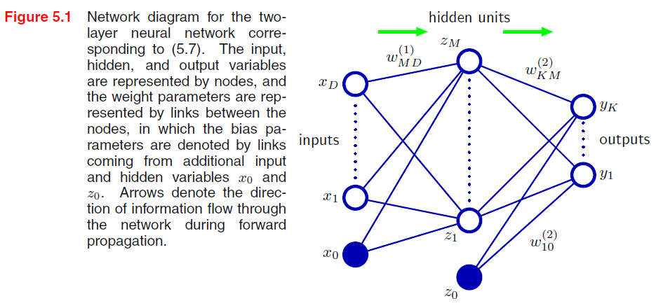
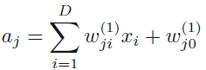
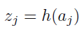
Neural network definition
Activations:
Nonlinear activation function h (e.g. sigmoid, RELU):
Recall SVM:
w^{T}x + b
Figure from Christopher Bishop

Slide 14
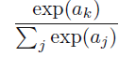
Neural network definition
Layer 2
Layer 3 (final)
Outputs (e.g. sigmoid/softmax)
Finally:
(multiclass)
(binary)
(binary)

Slide 15
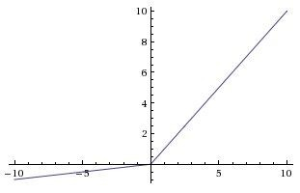
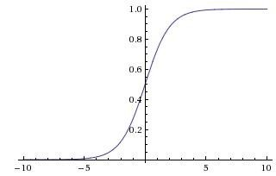
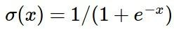
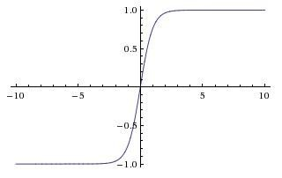
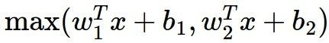
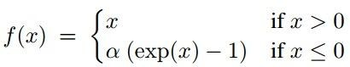
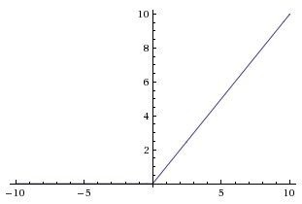
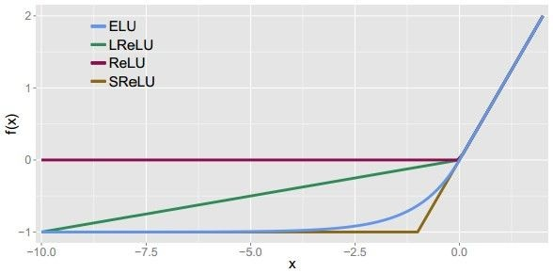
Leaky ReLU
max(0.1x, x)
Activation functions
Sigmoid
Maxout ELU
tanh
tanh(x)
ReLU
max(0,x)
Andrej Karpathy

Slide 16
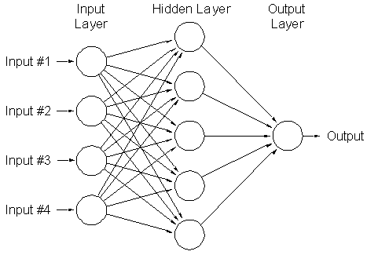
A multi-layer neural network
Nonlinear classifier
Can approximate any continuous function to arbitrary accuracy given sufficiently many hidden units
Lana Lazebnik

Slide 17


Inspiration: Neuron cells
Neurons
accept information from multiple inputs,
transmit information to other neurons.
Multiply inputs by weights along edges
Apply some function to the set of inputs at each node
If output of function over threshold, neuron “fires”
Text: HKUST, figures: Andrej Karpathy
Notes:
From Wikipedia: At the majority of synapses（突触）, signals are sent from the axon（轴突，神经细胞长的凸起，将信号传递给其他细胞） of one neuron to a dendrite（树突） of another... All neurons are electrically excitable, maintaining voltage gradients across their membranes… If the voltage changes by a large enough amount, an all-or-none electrochemical pulse called an action potential（动作电位） is generated, which travels rapidly along the cell's axon, and activates synaptic connections with other cells when it arrives.

Slide 18
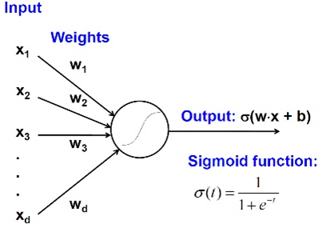
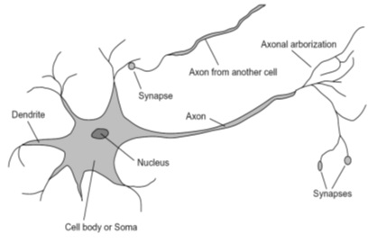
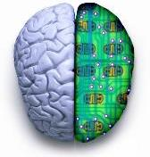
Biological analog
A biological neuron
An artificial neuron
Jia-bin Huang

Slide 19
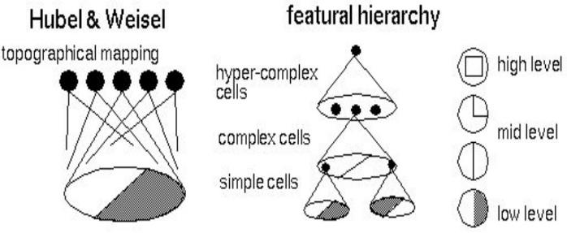
Biological analog
Hubel and Weisel’s architecture
Multi-layer neural network
Adapted from Jia-bin Huang

Slide 20
Multilayer networks
Cascade neurons together
Output from one layer is the input to the next
Each layer has its own sets of weights
HKUST

Slide 21
Feed-forward networks
Predictions are fed forward through the network to classify
HKUST

Slide 22
Feed-forward networks
Predictions are fed forward through the network to classify
HKUST

Slide 23
Feed-forward networks
Predictions are fed forward through the network to classify
HKUST

Slide 24
Feed-forward networks
Predictions are fed forward through the network to classify
HKUST

Slide 25
Feed-forward networks
Predictions are fed forward through the network to classify
HKUST

Slide 26
Feed-forward networks
Predictions are fed forward through the network to classify
HKUST

Slide 27
Deep neural networks
Lots of hidden layers
Depth = power (usually)
Weights to learn!
Weights to learn!
Weights to learn!
Weights to learn!
Figure from http://neuralnetworksanddeeplearning.com/chap5.html

Slide 28
How do we train them?
The goal is to iteratively find such a set of weights that allow the activations/outputs to match the desired output
We want to minimize a loss function
The loss function is a function of the weights in the network
For now let’s simplify and assume there’s a single layer of weights in the network

Slide 29
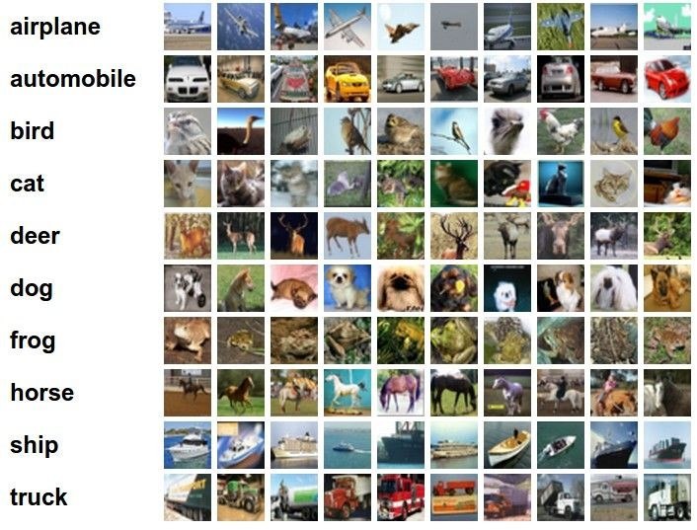
Classification goal
Example dataset: CIFAR-10 10 labels
50,000 training images each image is 32x32x3
10,000 test images.
Andrej Karpathy

Slide 30
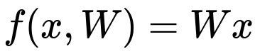
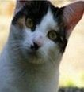
Classification scores
image
parameters
f(x,W)
10 numbers, indicating class scores
[32x32x3]
array of numbers 0...1 (3072 numbers total)
Andrej Karpathy

Slide 31
Linear classifier
3072x1
(+b)
10x1
10x1
10x3072
10 numbers, indicating class scores
[32x32x3]
array of numbers 0...1
parameters, or “weights”
Andrej Karpathy

Slide 32
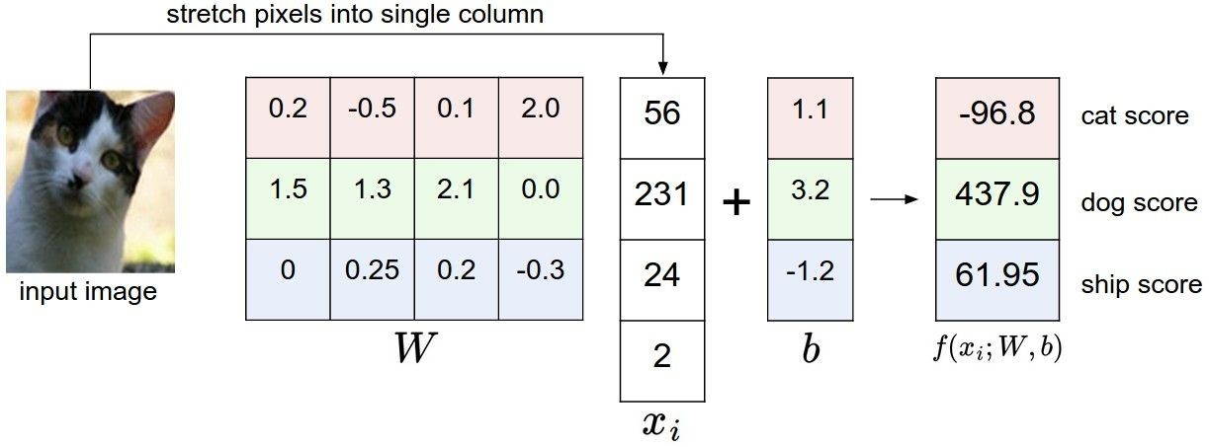
Linear classifier
Example with an image with 4 pixels, and 3 classes (cat/dog/ship)
Andrej Karpathy

Slide 33

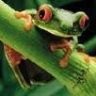
Linear classifier
Going forward: Loss function/Optimization
TODO:
1. Define a loss function that quantifies our unhappiness with the scores across the training data.
cat car frog
3.2
5.1
-1.7
1.3
4.9
2.0
2.2
2.5
-3.1
2. Come up with a way of efficiently finding the parameters that minimize the loss function. (optimization)
Andrej Karpathy

Slide 34
Linear classifier
Suppose: 3 training examples, 3 classes. With some W the scores
are:
cat car frog
3.2
5.1
-1.7
1.3
4.9
2.0
2.2
2.5
-3.1
Adapted from Andrej Karpathy

Slide 35
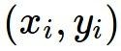
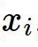
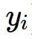
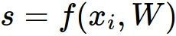
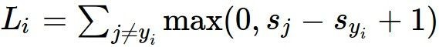
Linear classifier: Hinge loss
Suppose: 3 training examples, 3 classes. With some W the scores
Hinge loss:
Given an example
are:
where where
is the image and
is the (integer) label,
and using the shorthand for the scores vector:
cat car frog
the loss has the form:
3.2
5.1
-1.7
1.3
4.9
2.0
2.2
2.5
-3.1
Want: s_{yi} >= s_{j} + 1
i.e. s_{j} – s_{yi} + 1 <= 0
If true, loss is 0
If false, loss is magnitude of violation
Adapted from Andrej Karpathy

Slide 36
Linear classifier: Hinge loss
Suppose: 3 training examples, 3 classes. With some W the scores
Hinge loss:
Given an example
are:
where where
is the image and
is the (integer) label,
and using the shorthand for the scores vector:
the loss has the form:
cat car frog | 3.2 5.1 -1.7 | 1.3 2.2 4.9 2.5 2.0 -3.1
Losses: | 2.9
= max(0, 5.1 - 3.2 + 1)
+max(0, -1.7 - 3.2 + 1)
= max(0, 2.9) + max(0, -3.9)
= 2.9 + 0
= 2.9
Adapted from Andrej Karpathy

Slide 37
Linear classifier: Hinge loss
Suppose: 3 training examples, 3 classes. With some W the scores
Hinge loss:
Given an example
are:
where where
is the image and
is the (integer) label,
and using the shorthand for the scores vector:
the loss has the form:
cat 3.2 car 5.1 frog -1.7 | 1.3 4.9 2.0 | 2.2 2.5 -3.1
Losses: 2.9 | 0
= max(0, 1.3 - 4.9 + 1)
+max(0, 2.0 - 4.9 + 1)
= max(0, -2.6) + max(0, -1.9)
= 0 + 0
= 0
Adapted from Andrej Karpathy

Slide 38
Linear classifier: Hinge loss
Suppose: 3 training examples, 3 classes. With some W the scores
Hinge loss:
Given an example
are:
where where
is the image and
is the (integer) label,
and using the shorthand for the scores vector:
the loss has the form:
cat car frog | 3.2 5.1 -1.7 | 1.3 4.9 2.0 | 2.2 2.5 -3.1
Losses: | 2.9 | 0 | 12.9
= max(0, 2.2 - (-3.1) + 1)
+max(0, 2.5 - (-3.1) + 1)
= max(0, 5.3 + 1)
+ max(0, 5.6 + 1)
= 6.3 + 6.6
= 12.9
Adapted from Andrej Karpathy

Slide 39
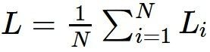
Linear classifier: Hinge loss
Suppose: 3 training examples, 3 classes. With some W the scores
Hinge loss:
Given an example
are:
where where
is the image and
is the (integer) label,
and using the shorthand for the scores vector:
cat car frog
the loss has the form:
3.2
5.1
-1.7
1.3
4.9
2.0
2.2
2.5
-3.1
and the full training loss is the mean over all examples in the training data:
L = (2.9 + 0 + 12.9)/3
Losses:
2.9
0
12.9
= 15.8 / 3 = 5.3
Lecture 3 - 12
Adapted from Andrej Karpathy

Slide 40
Linear classifier: Hinge loss
Adapted from Andrej Karpathy

Slide 41
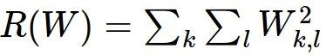
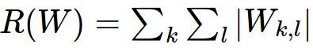
Linear classifier: Hinge loss
λ = regularization strength (hyperparameter)
Weight Regularization
In common use: L2 regularization L1 regularization
Dropout (will see later)
Adapted from Andrej Karpathy

Slide 42
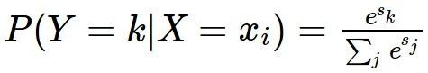
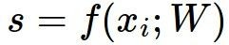
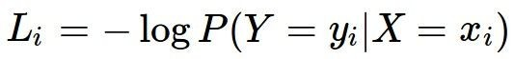
Another loss: Softmax (cross-entropy)
scores = unnormalized log probabilities of the classes.
where
cat car frog
Want to maximize the log likelihood, or (for a loss function) to minimize the negative log likelihood of the correct class:
3.2
5.1
-1.7
Andrej Karpathy

Slide 43
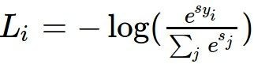
Another loss: Softmax (cross-entropy)
unnormalized probabilities
cat car frog
3.2 5.1 -1.7 | exp
0.13
0.87
0.00
24.5
164.0
0.18
L_i = -log(0.13)
= 0.89
normalize
unnormalized log probabilities
probabilities
Adapted from Andrej Karpathy

Slide 44
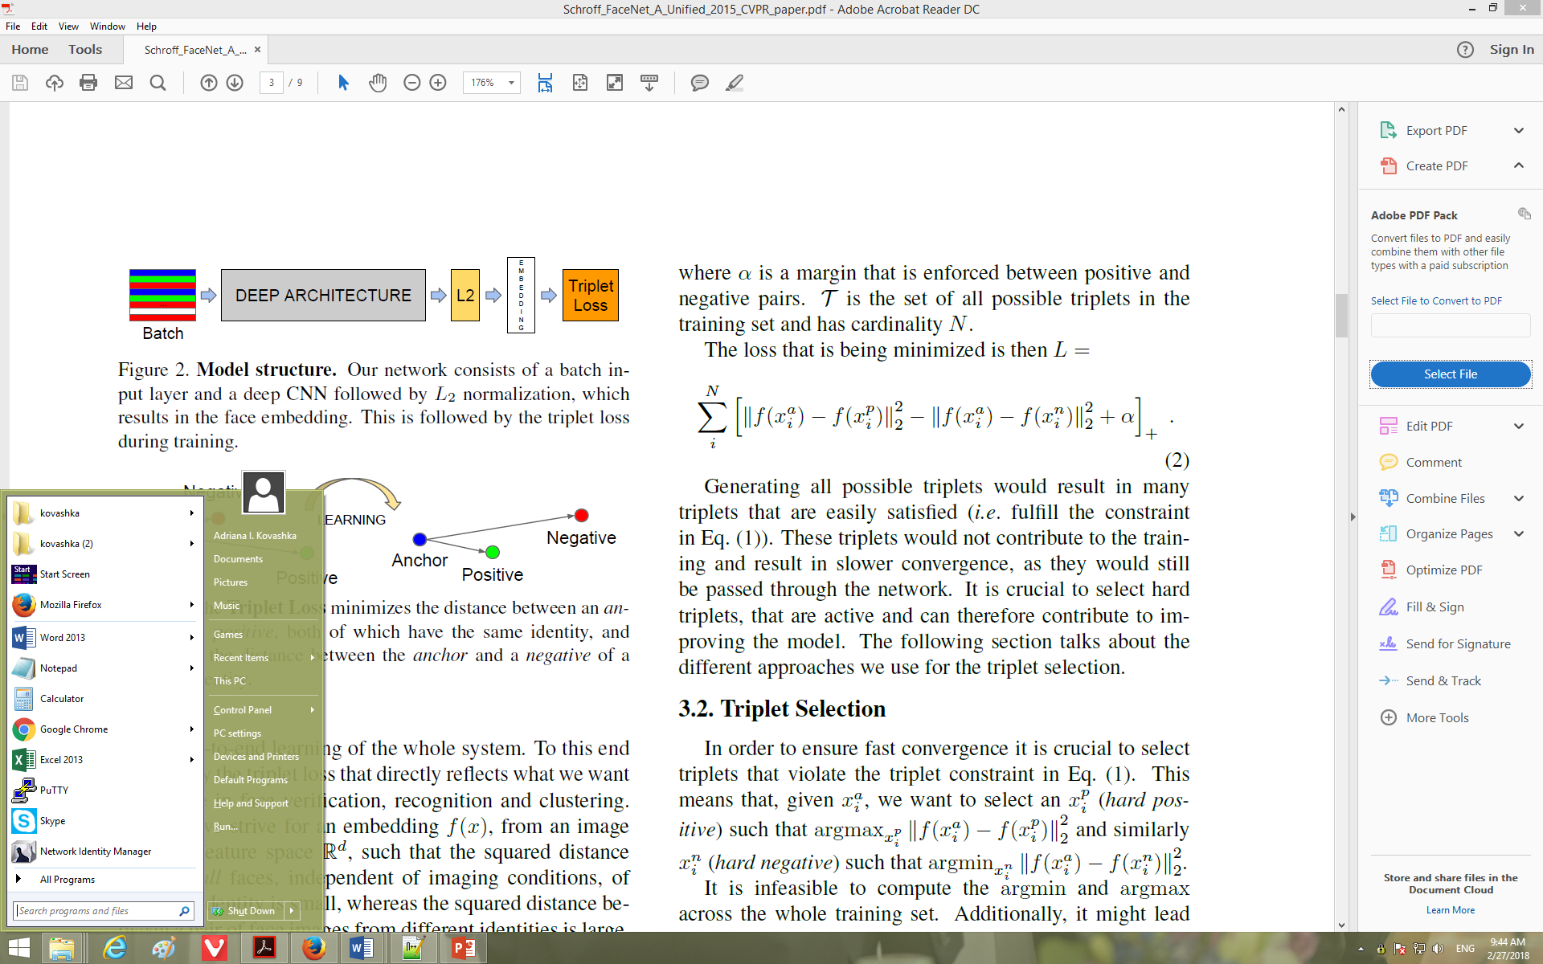
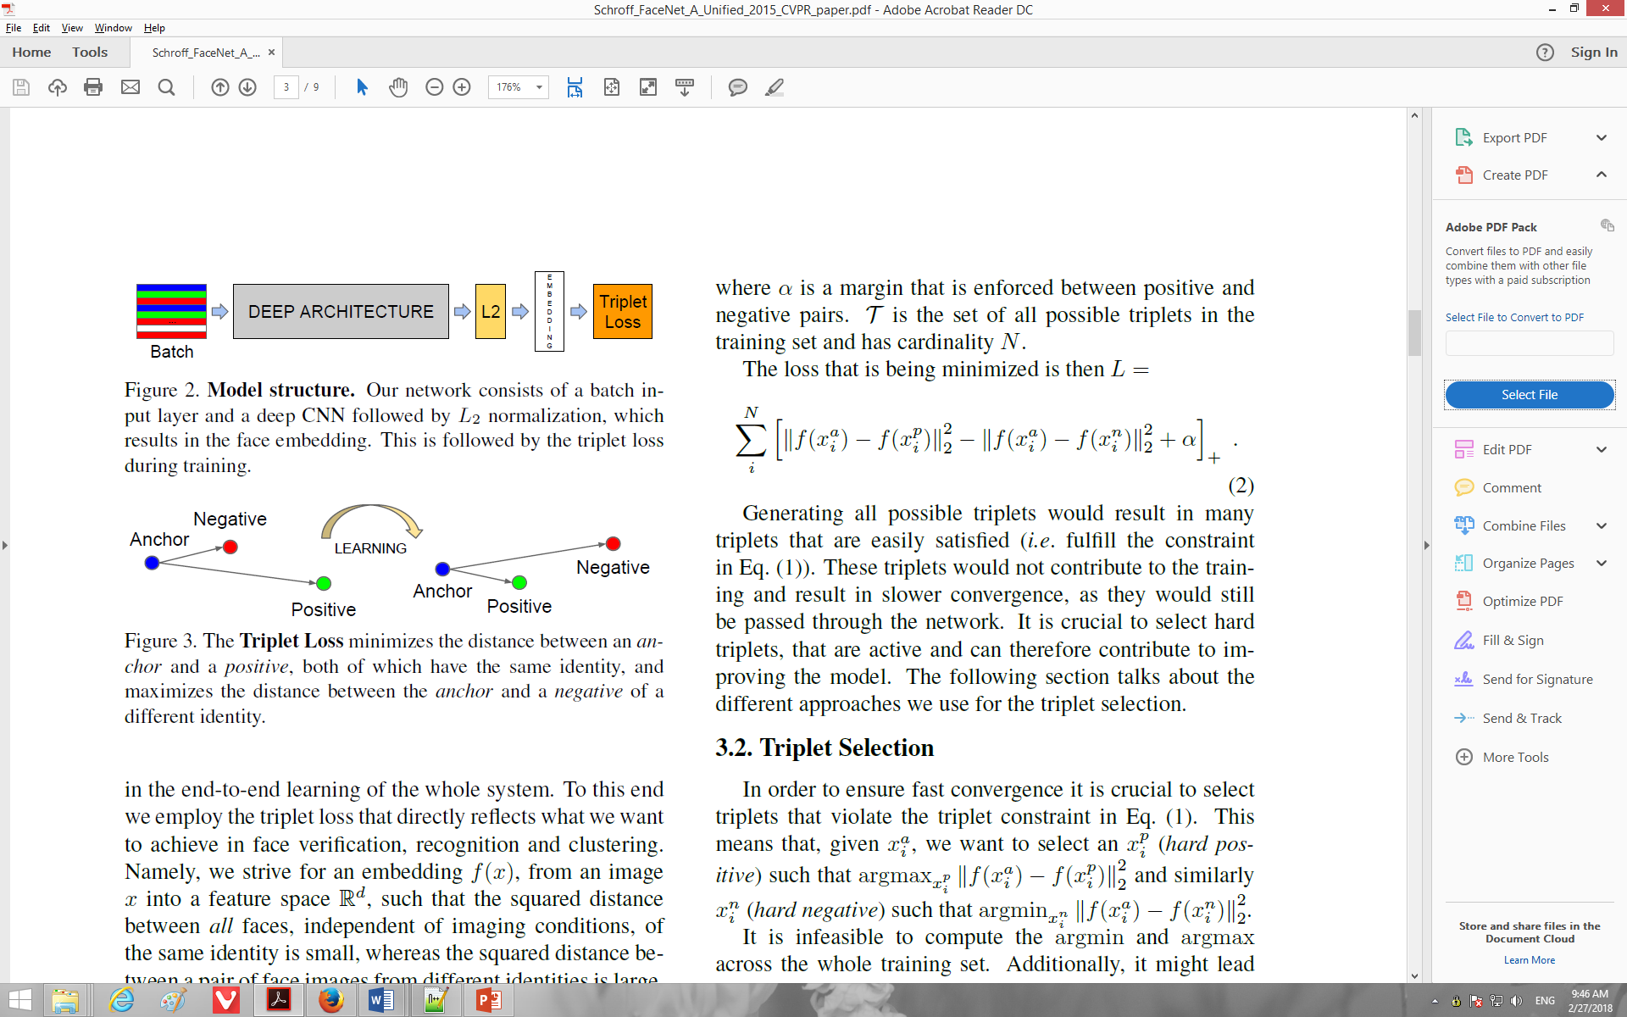
Other losses
Triplet loss (Schroff, FaceNet)
Anything you want!
a denotes anchor
p denotes positive
n denotes negative

Slide 45
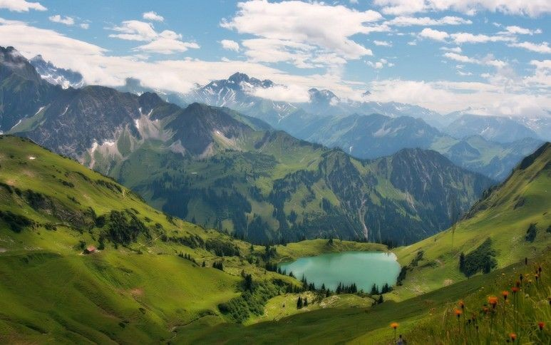

How to minimize the loss function?
Andrej Karpathy

Slide 46
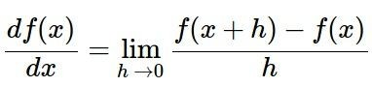
How to minimize the loss function?
In 1-dimension, the derivative of a function:
In multiple dimensions, the gradient is the vector of (partial derivatives).
Andrej Karpathy

Slide 47
current W:
gradient dW:
[0.34,
-1.11,
0.78,
0.12,
0.55,
2.81,
-3.1,
-1.5,
0.33,…]
loss 1.25347
[?,
?,
?,
?,
?,
?,
?,
?,
?,…]
Andrej Karpathy

Slide 48
current W:
W + h (first dim):
gradient dW:
[0.34,
-1.11,
0.78,
0.12,
0.55,
2.81,
-3.1,
-1.5,
0.33,…]
loss 1.25347
[0.34 + 0.0001,
-1.11,
0.78,
0.12,
0.55,
2.81,
-3.1,
-1.5,
0.33,…]
loss 1.25322
[?,
?,
?,
?,
?,
?,
?,
?,
?,…]
Andrej Karpathy

Slide 49
current W:
W + h (first dim):
gradient dW:
[0.34,
-1.11,
0.78,
0.12,
0.55,
2.81,
-3.1,
-1.5,
0.33,…]
loss 1.25347
[0.34 + 0.0001,
-1.11,
0.78,
0.12,
0.55,
2.81,
-3.1,
-1.5,
0.33,…]
loss 1.25322
[-2.5,
?,
?,
?,
?,
?,
?,
(1.25322 - 1.25347)/0.0001
= -2.5
?,
?,…]
Andrej Karpathy

Slide 50
current W:
W + h (second dim):
gradient dW:
[0.34,
-1.11,
0.78,
0.12,
0.55,
2.81,
-3.1,
-1.5,
0.33,…]
loss 1.25347
[0.34,
-1.11 + 0.0001,
0.78,
0.12,
0.55,
2.81,
-3.1,
-1.5,
0.33,…]
loss 1.25353
[-2.5,
?,
?,
?,
?,
?,
?,
?,
?,…]
Andrej Karpathy

Slide 51
current W:
W + h (second dim):
gradient dW:
[0.34,
-1.11,
0.78,
0.12,
0.55,
2.81,
-3.1,
-1.5,
0.33,…]
loss 1.25347
[0.34,
-1.11 + 0.0001,
0.78,
0.12,
0.55,
2.81,
-3.1,
-1.5,
0.33,…]
loss 1.25353
[-2.5,
0.6,
?,
?,
?,
?,
?,
?,
(1.25353 - 1.25347)/0.0001
= 0.6
?,…]
Andrej Karpathy

Slide 52
current W:
W + h (third dim):
gradient dW:
[0.34,
-1.11,
0.78,
0.12,
0.55,
2.81,
-3.1,
-1.5,
0.33,…]
loss 1.25347
[0.34,
-1.11,
0.78 + 0.0001,
0.12,
0.55,
2.81,
-3.1,
-1.5,
0.33,…]
loss 1.25347
[-2.5,
0.6,
?,
?,
?,
?,
?,
?,
?,…]
Andrej Karpathy

Slide 53
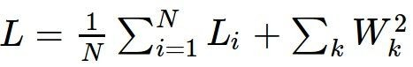
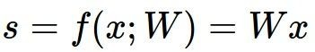
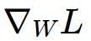
This is silly. The loss is just a function of W:
want
Andrej Karpathy

Slide 54

This is silly. The loss is just a function of W:
want
Calculus
= ...
Andrej Karpathy

Slide 55
current W:
gradient dW:
[0.34,
-1.11,
0.78,
0.12,
0.55,
2.81,
-3.1,
-1.5,
0.33,…]
loss 1.25347
[-2.5,
0.6,
0,
0.2,
0.7,
-0.5,
1.1,
1.3,
-2.1,…]
dW = ...
(some function data and W)
Andrej Karpathy

Slide 56
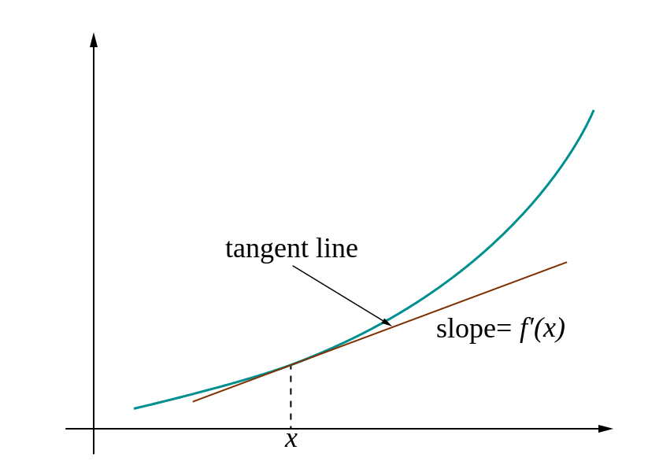
Loss gradients
Denoted as (diff notations):
i.e. how does the loss change as a function of the weights
We want to change the weights in such a way that makes the loss decrease as fast as possible

Slide 57
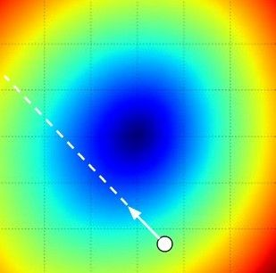
Gradient descent
We’ll update weights
Move in direction opposite to gradient:
L
Time
Learning rate
W_2
original W
W_1
negative gradient direction
Figure from Andrej Karpathy

Slide 58
Gradient descent
Iteratively subtract the gradient with respect to the model parameters (w)
I.e. we’re moving in a direction opposite to the gradient of the loss
I.e. we’re moving towards smaller loss

Slide 59
Mini-batch gradient descent
In classic gradient descent, we compute the gradient from the loss for all training examples
Could also only use some of the data for each gradient update
We cycle through all the training examples multiple times
Each time we’ve cycled through all of them once is called an ‘epoch’
Allows faster training (e.g. on GPUs), parallelization

Slide 60
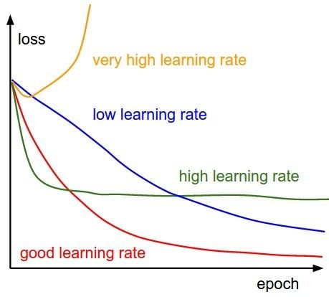
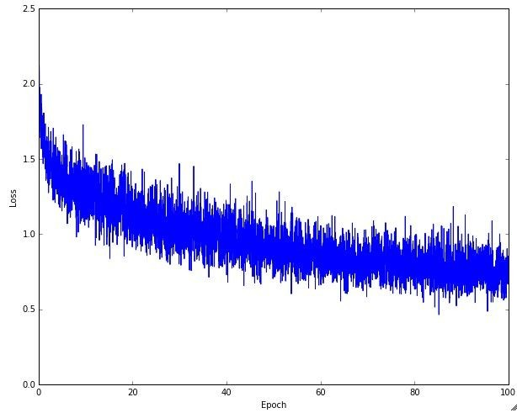
Learning rate selection
The effects of step size (or “learning rate”)
Andrej Karpathy

Slide 61
Gradient descent in multi-layer nets
We’ll update weights
Move in direction opposite to gradient:
How to update the weights at all layers?
Answer: backpropagation of error from higher layers to lower layers

Slide 62
Backpropagation: Graphic example
First calculate error of output units and use this to change the top layer of weights.
output
k
j
i
Update weights into j
w⁽²⁾
hidden
w⁽¹⁾
input
Adapted from Ray Mooney, equations from Chris Bishop

Slide 63
Backpropagation: Graphic example
Next calculate error for hidden units based on errors on the output units it feeds into.
output
k
j
i
hidden
input
Adapted from Ray Mooney, equations from Chris Bishop

Slide 64
Backpropagation: Graphic example
Finally update bottom layer of weights based on errors calculated for hidden units.
output
k
j
i
Update weights into i
hidden
input
Adapted from Ray Mooney, equations from Chris Bishop

Slide 65
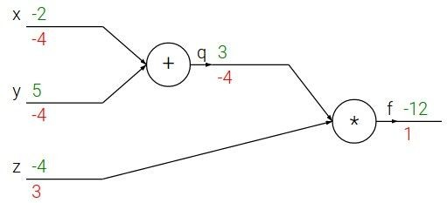

e.g. x = -2, y = 5, z = -4
Fei-Fei Li & Andrej Karpathy & Justin Johnson Lecture 4 - 13 Jan 2016
Lecture 4 - 10
Andrej Karpathy
Notes:
https://www.youtube.com/watch?v=QWfmCyLEQ8U&list=PL16j5WbGpaM0_Tj8CRmurZ8Kk1gEBc7fg&index=4

Slide 66





e.g. x = -2, y = 5, z = -4
Want:
Fei-Fei Li & Andrej Karpathy & Justin Johnson Lecture 4 - 13 Jan 2016
Lecture 4 - 11
Andrej Karpathy

Slide 67

e.g. x = -2, y = 5, z = -4
Want:
Fei-Fei Li & Andrej Karpathy & Justin Johnson Lecture 4 - 13 Jan 2016
Lecture 4 - 12
Andrej Karpathy

Slide 68
e.g. x = -2, y = 5, z = -4
Want:
Fei-Fei Li & Andrej Karpathy & Justin Johnson Lecture 4 - 13 Jan 2016
Lecture 4 - 13
Andrej Karpathy

Slide 69

e.g. x = -2, y = 5, z = -4
Want:
Fei-Fei Li & Andrej Karpathy & Justin Johnson Lecture 4 - 13 Jan 2016
Lecture 4 - 14
Andrej Karpathy

Slide 70
e.g. x = -2, y = 5, z = -4
Want:
Fei-Fei Li & Andrej Karpathy & Justin Johnson Lecture 4 - 13 Jan 2016
Lecture 4 - 15
Andrej Karpathy

Slide 71

e.g. x = -2, y = 5, z = -4
Want:
Fei-Fei Li & Andrej Karpathy & Justin Johnson Lecture 4 - 13 Jan 2016
Lecture 4 - 16
Andrej Karpathy

Slide 72
e.g. x = -2, y = 5, z = -4
Want:
Fei-Fei Li & Andrej Karpathy & Justin Johnson Lecture 4 - 13 Jan 2016
Lecture 4 - 17
Andrej Karpathy

Slide 73

e.g. x = -2, y = 5, z = -4
Want:
Fei-Fei Li & Andrej Karpathy & Justin Johnson Lecture 4 - 13 Jan 2016
Lecture 4 - 18
Andrej Karpathy

Slide 74


e.g. x = -2, y = 5, z = -4
Chain rule:
Want:
Fei-Fei Li & Andrej Karpathy & Justin Johnson Lecture 4 - 13 Jan 2016
Lecture 4 - 19
Andrej Karpathy

Slide 75

e.g. x = -2, y = 5, z = -4
Want:
Fei-Fei Li & Andrej Karpathy & Justin Johnson Lecture 4 - 13 Jan 2016
Lecture 4 - 20
Andrej Karpathy

Slide 76
e.g. x = -2, y = 5, z = -4
Chain rule:
Want:
Fei-Fei Li & Andrej Karpathy & Justin Johnson Lecture 4 - 13 Jan 2016
Lecture 4 - 21
Andrej Karpathy

Slide 77


activations
f
Fei-Fei Li & Andrej Karpathy & Justin Johnson Lecture 4 - 13 Jan 2016
Lecture 4 - 22
Andrej Karpathy

Slide 78


activations
“local gradient”
f
gradients
Fei-Fei Li & Andrej Karpathy & Justin Johnson Lecture 4 - 13 Jan 2016
Lecture 4 - 23
Andrej Karpathy

Slide 79

activations
“local gradient”
f
gradients
Fei-Fei Li & Andrej Karpathy & Justin Johnson Lecture 4 - 13 Jan 2016
Lecture 4 - 24
Andrej Karpathy

Slide 80

activations
“local gradient”
f
gradients
Fei-Fei Li & Andrej Karpathy & Justin Johnson Lecture 4 - 13 Jan 2016
Lecture 4 - 25
Andrej Karpathy

Slide 81

activations
“local gradient”
f
gradients
Fei-Fei Li & Andrej Karpathy & Justin Johnson Lecture 4 - 13 Jan 2016
Lecture 4 - 26
Andrej Karpathy

Slide 82
Convolutional neural networks

Slide 83


Convolutional Neural Networks (CNN)
Neural network with specialized connectivity structure
Stack multiple stages of feature extractors
Higher stages compute more global, more invariant, more abstract features
Classification layer at the end
Y. LeCun, L. Bottou, Y. Bengio, and P. Haffner, Gradient-based learning applied to document recognition, Proceedings of the IEEE 86(11): 2278–2324, 1998.
Adapted from Rob Fergus

Slide 84
Convolutional Neural Networks (CNN)
Feed-forward feature extraction:
Convolve input with learned filters
Apply non-linearity
Spatial pooling (downsample)
Supervised training of convolutional filters by back-propagating classification error
Output (class probs)
…
Spatial pooling
Non-linearity
Convolution (Learned)
Input Image
Adapted from Lana Lazebnik

Slide 85





1. Convolution
Apply learned filter weights
One feature map per filter
Stride can be greater than 1 (faster, less memory)
...
Input
Feature Map
Adapted from Rob Fergus

Slide 86



2. Non-Linearity
Per-element (independent)
Some options:
Tanh
Sigmoid: 1/(1+exp(-x))
Rectified linear unit (ReLU)
Avoids saturation issues
Adapted from Rob Fergus
Notes:
Saturation:饱和性

Slide 87


3. Spatial Pooling
Sum or max over non-overlapping / overlapping regions
Rob Fergus, figure from Andrej Karpathy

Slide 88



3. Spatial Pooling
Sum or max over non-overlapping / overlapping regions
Role of pooling:
Invariance to small transformations
Larger receptive fields (neurons see more of input)
Max
Sum
Adapted from Rob Fergus

Slide 89
Convolutions: More detail
32x32x3 image
32
height
32
depth
width
3
Andrej Karpathy

Slide 90
Convolutions: More detail
32x32x3 image
5x5x3 filter
32
Convolve the filter with the image
i.e. “slide over the image spatially, computing dot products”
32
3
Andrej Karpathy

Slide 91


Convolution Layer
Convolutions: More detail
32x32x3 image 5x5x3 filter
32
1 number:
the result of taking a dot product between the filter and a small 5x5x3 chunk of the image
(i.e. 5*5*3 = 75-dimensional dot product + bias)
32
3
Andrej Karpathy

Slide 92
Convolution Layer
Convolutions: More detail
activation map
32x32x3 image
5x5x3 filter
32
28
convolve (slide) over all spatial locations
32
28
3
1
Andrej Karpathy

Slide 93
consider a second, green filter
Convolutions: More detail
Convolution Layer
32x32x3 image 5x5x3 filter
activation maps
32
28
convolve (slide) over all spatial locations
32
28
3
1
Andrej Karpathy

Slide 94
For example, if we had 6 5x5 filters, we’ll get 6 separate activation maps:
Convolutions: More detail
activation maps
32
28
Convolution Layer
32
28
3
6
We stack these up to get a “new image” of size 28x28x6!
Andrej Karpathy

Slide 95
Preview: ConvNet is a sequence of Convolution Layers, interspersed with activation functions
Convolutions: More detail
32
28
CONV, ReLU
e.g. 6 5x5x3 filters
32
28
3
6
Andrej Karpathy

Slide 96
Preview: ConvNet is a sequence of Convolutional Layers, interspersed with activation functions
Convolutions: More detail
32
28
24
….
CONV, ReLU
e.g. 6 5x5x3 filters
CONV, ReLU
e.g. 10 5x5x6 filters
CONV, ReLU
32
28
24
3
6
10
Andrej Karpathy

Slide 97

Preview
Convolutions: More detail
[From recent Yann LeCun slides]
Andrej Karpathy

Slide 98


one filter =>
one activation map
Convolutions: More detail
example 5x5 filters
(32 total)
We call the layer convolutional because it is related to convolution of two signals:
Element-wise multiplication and sum of a filter and the signal (image)
Adapted from Andrej Karpathy, Kristen Grauman

Slide 99
A closer look at spatial dimensions:
Convolutions: More detail
activation map
32x32x3 image
5x5x3 filter
32
28
convolve (slide) over all spatial locations
32
28
3
1
Andrej Karpathy

Slide 100
A closer look at spatial dimensions:
Convolutions: More detail
7
7x7 input (spatially) assume 3x3 filter
7
Andrej Karpathy

Slide 101
A closer look at spatial dimensions:
Convolutions: More detail
7
7x7 input (spatially) assume 3x3 filter
7
Andrej Karpathy

Slide 102
A closer look at spatial dimensions:
Convolutions: More detail
7
7x7 input (spatially) assume 3x3 filter
7
Andrej Karpathy

Slide 103
A closer look at spatial dimensions:
Convolutions: More detail
7
7x7 input (spatially) assume 3x3 filter
7
Andrej Karpathy

Slide 104
A closer look at spatial dimensions:
Convolutions: More detail
7
7x7 input (spatially) assume 3x3 filter
=> 5x5 output
7
Andrej Karpathy

Slide 105
A closer look at spatial dimensions:
Convolutions: More detail
7
7x7 input (spatially) assume 3x3 filter applied with stride 2
7
Andrej Karpathy

Slide 106
A closer look at spatial dimensions:
Convolutions: More detail
7
7x7 input (spatially) assume 3x3 filter applied with stride 2
7
Andrej Karpathy

Slide 107
A closer look at spatial dimensions:
Convolutions: More detail
7
7x7 input (spatially) assume 3x3 filter applied with stride 2
=> 3x3 output!
7
Andrej Karpathy

Slide 108
A closer look at spatial dimensions:
Convolutions: More detail
7
7x7 input (spatially) assume 3x3 filter applied with stride 3?
7
Andrej Karpathy

Slide 109
A closer look at spatial dimensions:
Convolutions: More detail
7
7x7 input (spatially) assume 3x3 filter applied with stride 3?
7
doesn’t fit!
cannot apply 3x3 filter on 7x7 input with stride 3.
Andrej Karpathy

Slide 110
Convolutions: More detail
N
Output size:
(N - F) / stride + 1
 |  |  | F
 | F
e.g. N = 7, F = 3:
stride 1 => (7 - 3)/1 + 1 = 5
stride 2 => (7 - 3)/2 + 1 = 3
stride 3 => (7 - 3)/3 + 1 = 2.33 :\
N
Andrej Karpathy

Slide 111
In practice: Common to zero pad the border
Convolutions: More detail
0 | 0 | 0 | 0 | 0 | 0
0
0
0
0
e.g. input 7x7
3x3 filter, applied with stride 1
pad with 1 pixel border => what is the output?
(recall:)
(N - F) / stride + 1
Andrej Karpathy

Slide 112
In practice: Common to zero pad the border
Convolutions: More detail
0 | 0 | 0 | 0 | 0 | 0
0
0
0
0
e.g. input 7x7
3x3 filter, applied with stride 1
pad with 1 pixel border => what is the output?
7x7 output!
Andrej Karpathy

Slide 113
In practice: Common to zero pad the border
Convolutions: More detail
0 | 0 | 0 | 0 | 0 | 0
0
0
0
0
e.g. input 7x7
3x3 filter, applied with stride 1
pad with 1 pixel border => what is the output?
7x7 output!
in general, common to see CONV layers with stride 1, filters of size FxF, and zero-padding with (F-1)/2. (will preserve size spatially)
e.g. F = 3 => zero pad with 1 F = 5 => zero pad with 2 F = 7 => zero pad with 3
(N + 2*padding - F) / stride + 1
Andrej Karpathy

Slide 114
Convolutions: More detail
Examples time:
Input volume: 32x32x3
10 5x5 filters with stride 1, pad 2
Output volume size: ?
Andrej Karpathy

Slide 115
Convolutions: More detail
Examples time:
Input volume: 32x32x3
10 5x5 filters with stride 1, pad 2
Output volume size:
(32+2*2-5)/1+1 = 32 spatially, so
32x32x10
Andrej Karpathy

Slide 116
Convolutions: More detail
Examples time:
Input volume: 32x32x3
10 5x5 filters with stride 1, pad 2
Number of parameters in this layer?
Andrej Karpathy

Slide 117
Examples time:
Convolutions: More detail
Input volume: 32x32x3
10 5x5 filters with stride 1, pad 2
Number of parameters in this layer? each filter has 5*5*3 + 1 = 76 params
=> 76*10 = 760
(+1 for bias)
Andrej Karpathy

Slide 118

Putting it all together
Andrej Karpathy

Slide 119

A Common Architecture: AlexNet
Figure from http://www.mdpi.com/2072-4292/7/11/14680/htm

Slide 120

Case Study: VGGNet
[Simonyan and Zisserman, 2014]
Only 3x3 CONV stride 1, pad 1 and 2x2 MAX POOL stride 2
best model
11.2% top 5 error in ILSVRC 2013
->
7.3% top 5 error
Top-5 error, also known as rank-5 error is simply an instantiation of Rank-N error metric with (N=5). Rank N error is the fraction of test samples xi where the correct label yi does not appear in the top N predicted results of the model when results are sorted in decreasing order of confidence, or P(yi|xi).
Andrej Karpathy
Notes:
Top-5 error, also known as rank-5 error is simply an instantiation of Rank-N error metric with (N=5). Rank N error is the fraction of test samples xi where the correct label yi does not appear in the top N predicted results of the model when results are sorted in decreasing order of confidence, or P(yi|xi).

Slide 121


Case Study: GoogLeNet
[Szegedy et al., 2014]
Inception module
ILSVRC 2014 winner (6.7% top 5 error)
Andrej Karpathy

Slide 122

Case Study: ResNet
[He et al., 2015]
ILSVRC 2015 winner (3.6% top 5 error)
Slide from Kaiming He’s recent presentation https://www.youtube.com/watch?v=1PGLj-uKT1w
Andrej Karpathy

Slide 123

Case Study: ResNet
(slide from Kaiming He’s recent presentation)
Andrej Karpathy

Slide 124

Case Study: ResNet
[He et al., 2015]
ILSVRC 2015 winner (3.6% top 5 error)
2-3 weeks of training on 8 GPU machine
at runtime: faster than a VGGNet! (even though it has 8x more layers)
(slide from Kaiming He’s recent presentation)
Andrej Karpathy

Slide 125


Slide 126


Slide 127
Practical matters

Slide 128
Comments on training algorithm
Not guaranteed to converge to zero training error, may converge to local optima or oscillate indefinitely.
However, in practice, does converge to low error for many large networks on real data, with good choice of hyperparameters (e.g. learning rate).
Thousands of epochs (epoch = network sees all training data once) may be required, hours or days to train.
To avoid local-minima problems, run several trials starting with different random weights (random restarts), and take results of trial with lowest training set error.
May be hard to set learning rate and to select number of hidden units and layers.
Neural networks had fallen out of fashion in 90s, early 2000s; back with a new name and improved performance (deep networks trained with dropout and lots of data).
Ray Mooney, Carlos Guestrin, Dhruv Batra

Slide 129
Over-training prevention
Running too many epochs can result in over-fitting.
Keep a hold-out validation set and test accuracy on it after every epoch. Stop training when additional epochs actually increase validation error.
error
on test data
on training data
0
# training epochs
Adapted from Ray Mooney

Slide 130
Training: Best practices
Use regularization
To initialize weights, use “Xavier initialization”
Use RELU or leaky RELU or ELU, don’t use sigmoid
Use data augmentation
Use mini-batch
Center (subtract mean from) your data
Use cross-validation for your parameters
Learning rate: too high? Too low?

Slide 131


Regularization: Dropout
Randomly turn off some neurons
Allows individual neurons to independently be responsible for performance
Dropout: A simple way to prevent neural networks from overfitting [Srivastava JMLR 2014]
Adapted from Jia-bin Huang

Slide 132

Data Augmentation (Jittering)
Create virtual training samples
Horizontal flip
Random crop
Color casting
Geometric distortion
Jia-bin Huang, Image: https://github.com/aleju/imgaug

Slide 133
Transfer Learning
“You need a lot of a data if you want to train/use CNNs”
BUSTED
Andrej Karpathy

Slide 134
Transfer Learning with CNNs
The more weights you need to learn, the more data you need
That’s why with a deeper network, you need more data for training than for a shallower network
One possible solution:
Set these to the already learned
weights from another network
Learn these on your own task

Slide 135

Transfer Learning with CNNs
Source: classification on ImageNet Target: some other task/data
1. Train on ImageNet
2. Small dataset:
3. Medium dataset:
finetuning
more data = retrain more of the network (or all of it)
Freeze these
Freeze these
Train this
Train this
Lecture 11 - 29
Another option: use network as feature extractor,
train SVM on extracted features for target task
Adapted from Andrej Karpathy

Slide 136
more generic
Transfer Learning with CNNs
 | very similar dataset | very different dataset
very little data | Use linear classifier on top layer | You’re in trouble… Try linear classifier from different stages
quite a lot of data | Finetune a few layers | Finetune a larger number of layers
more specific
Lecture 11 - 34
Andrej Karpathy

Slide 137

Pre-training on ImageNet
Have a source domain and target domain
Train a network to classify ImageNet classes
Coarse classes and ones with fine distinctions (dog breeds)
Remove last layers and train layers to replace them, that predict target classes
Oquab et al., “Learning and Transferring Mid-Level Image Representations…”, CVPR 2014

Slide 138

Transfer learning with CNNs is pervasive…
Image Captioning
Karpathy and Fei-Fei, “Deep Visual-Semantic Alignments for Generating Image Descriptions”, CVPR 2015
CNN pretrained on ImageNet
Object Detection
Ren et al., “Faster R-CNN“, NIPS 2015
Adapted from Andrej Karpathy

Slide 139



Semantic segmentation
Extract patch
Run through a CNN
Classify center pixel
CNN
COW
Repeat for every pixel
Lecture 13 -
28
Andrej Karpathy

Slide 140

Photographer identification
Who took this photograph?
Deep net features achieve 74% accuracy
Chance is less than 3%, human performance is 47%
Method learns what proto-objects + scenes authors shoot
Thomas and Kovashka, CVPR 2016

Slide 141
Analysis of pre-training on ImageNet
Source:
distinguish 1000 ImageNet categories (incl. many dog breeds)
Target tasks:
object detection and action recognition on PASCAL
scene recognition on SUN
Pre-training with 500 images per class is about as good as pre-training with 1000
Pre-training with 127 classes is about as good as pre-training with 1000
Pre-training with (fewer classes, more images per class) > (more classes, fewer images)
Small drop in if classes with fine-grained distinctions removed from pre-training set
Huh et al., “What makes ImageNet good for transfer learning?”, arxiv 2016

Slide 142
Packages
TensorFlow
Torch / PyTorch
Keras
Caffe and Caffe Model Zoo

Slide 143
Some Learning Resources
http://deeplearning.net/
http://cs231n.stanford.edu

Slide 144
Understanding CNNs

Slide 145
Recall: Biological analog
Hubel and Weisel’s architecture
Multi-layer neural network
Adapted from Jia-bin Huang

Slide 146

Layer 1
Visualizing and Understanding Convolutional Networks [Zeiler and Fergus, ECCV 2014]
Notes:
总的来说，通过CNN学习后，我们学习到的特征，是具有辨别性的特征，比如要我们区分人脸和狗头，那么通过CNN学习后，背景部位的激活度基本很少，我们通过可视化就可以看到我们提取到的特征忽视了背景，而是把关键的信息给提取出来了。从layer 1、layer 2学习到的特征基本上是颜色、边缘等低层特征；layer 3则开始稍微变得复杂，学习到的是纹理特征，比如上面的一些网格纹理；layer 4学习到的则是比较有区别性的特征，比如狗头；layer 5学习到的则是完整的，具有辨别性关键特征。

Slide 147

Layer 2
Activations projected down to pixel level via decovolution
Patches from validation images that give maximal activation of a given feature map
Visualizing and Understanding Convolutional Networks [Zeiler and Fergus, ECCV 2014]

Slide 148

Layer 3
Visualizing and Understanding Convolutional Networks [Zeiler and Fergus, ECCV 2014]

Slide 149

Layer 4 and 5
Visualizing and Understanding Convolutional Networks [Zeiler and Fergus, ECCV 2014]

Slide 150
总结
总的来说，通过CNN学习后，我们学习到的特征，是具有辨别性的特征，我们通过可视化就可以看到我们提取到的特征忽视了背景，而是把关键的信息给提取出来了。从layer 1、layer 2学习到的特征基本上是颜色、边缘等低层特征；layer 3则开始稍微变得复杂，学习到的是纹理特征，比如上面的一些网格纹理；layer 4学习到的则是比较有区别性的特征，比如狗头；layer 5学习到的则是完整的，具有辨别性关键特征。

Slide 151


Occlusion experiments
(as a function of the position of the square of zeros in the original image)
Occlusion experiments are performed to determine which patches of the image contribute maximally to the output of a neural network. The occlusion experiments tell us that our convolution neural network is actually learning some meaning patterns like detecting the face of a dog from the input.
[Zeiler & Fergus 2014]
Andrej Karpathy

Slide 152
Occlusion experiments
(as a function of the position of the square of zeros in the original image)
[Zeiler & Fergus 2014]
Andrej Karpathy
Notes:
Occlusion experiments are performed to determine which patches of the image contribute maximally to the output of a neural network. ... The occlusion experiments tell us that our convolution neural network is actually learning some meaning patterns like detecting the face of a dog from the input.

Slide 153

Breaking CNNs
Intriguing properties of neural networks [Szegedy ICLR 2014]
Andrej Karpathy

Slide 154

Fooling a linear classifier
To fool a linear classifier, add a small multiple of the weight vector to the training example:
x ← x + α w
http://karpathy.github.io/2015/03/30/breaking-convnets/
Jia-bin Huang

Slide 155
Summary
We use deep neural networks because of their strong performance in practice
Convolutional neural network (CNN)
Convolution, nonlinearity, max pooling
Training deep neural nets
We need an objective function that measures and guides us towards good performance
We need a way to minimize the loss function: stochastic gradient descent
We need backpropagation to propagate error towards all layers and change weights at those layers
Practices for preventing overfitting
Dropout; data augmentation; transfer learning

